Slide 1

US 2020 Elections
An Analysis of US Voting Habits Using Python
Nicolas Michel
Xiran Fang
Suosi He

Slide 2

Data Collection I
1

Slide 3
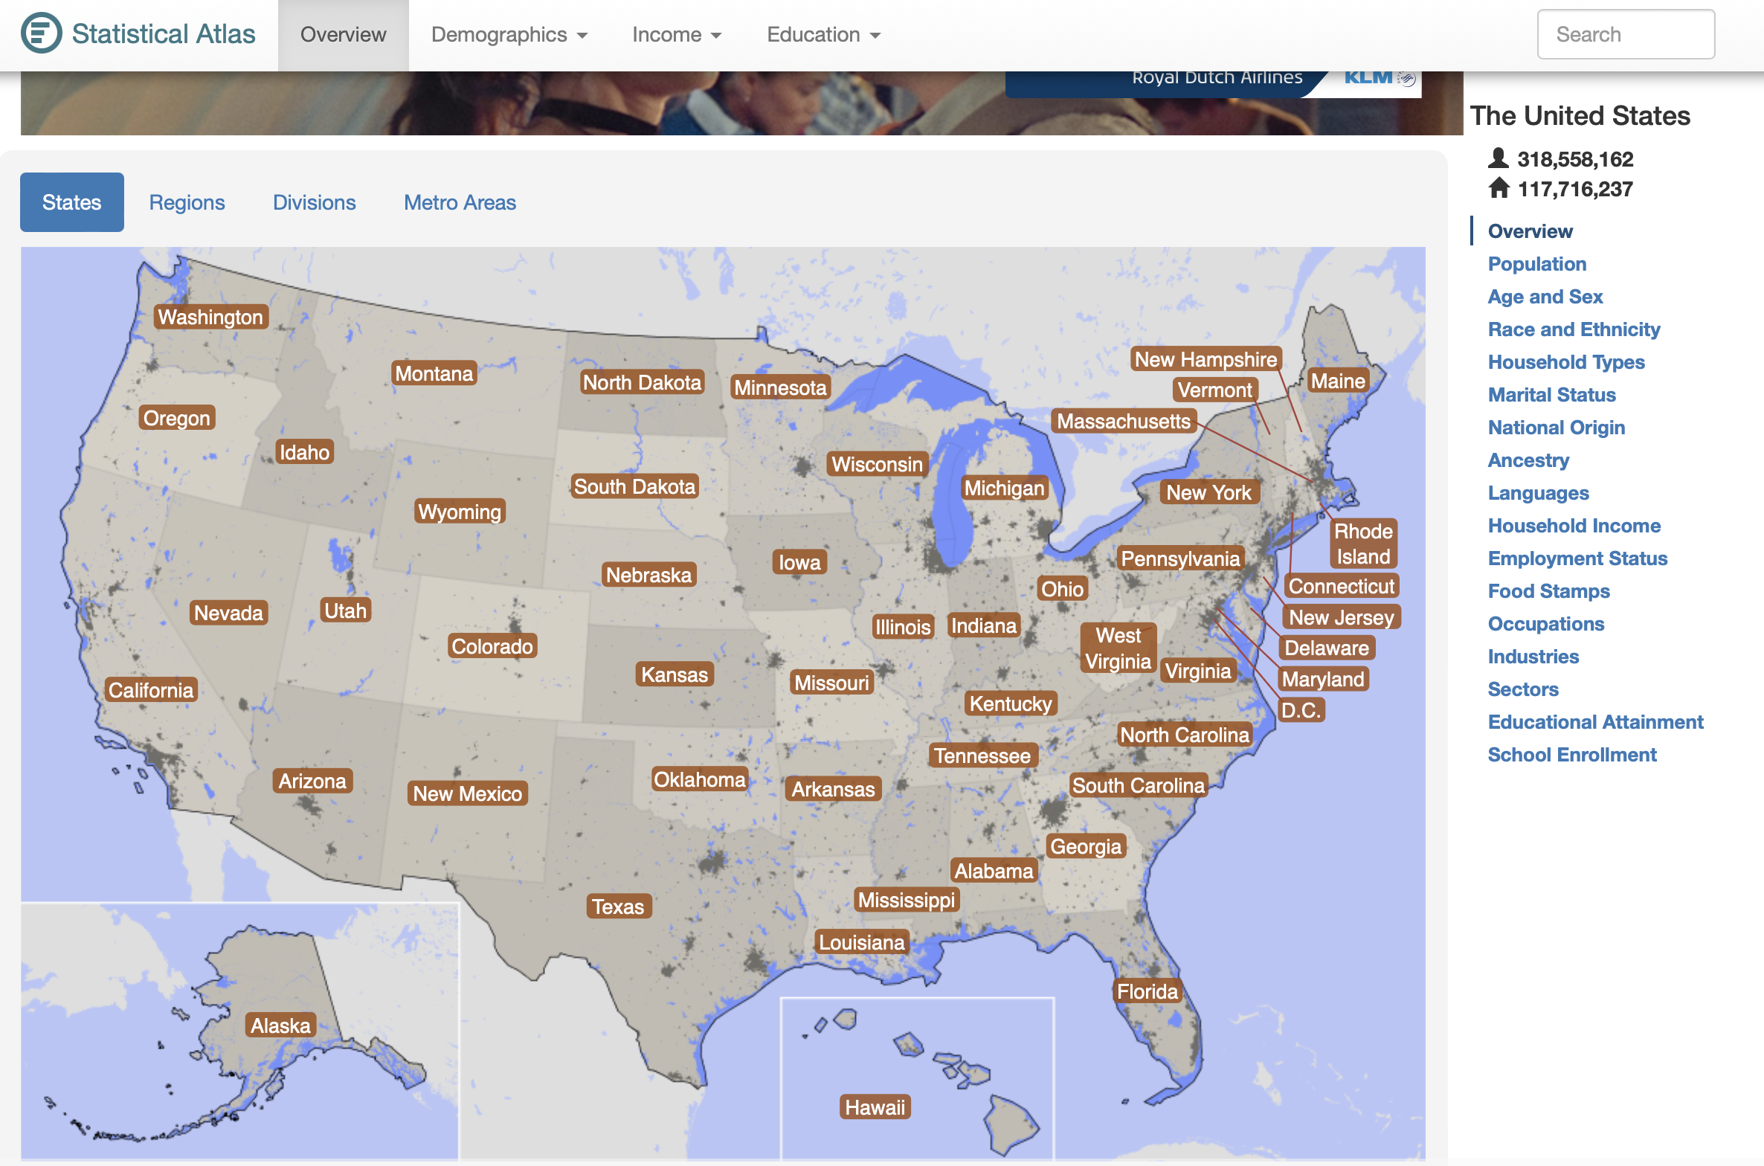
Data Collection II
2

Slide 4
Data Collection III
Data chosen to analyse:
US 2020 electoral votes by state
State breakdown of racial groups
State breakdown of educational attainment
Number of individuals eligible to vote (and number that did) by state
Median Income of each state
3

Slide 5
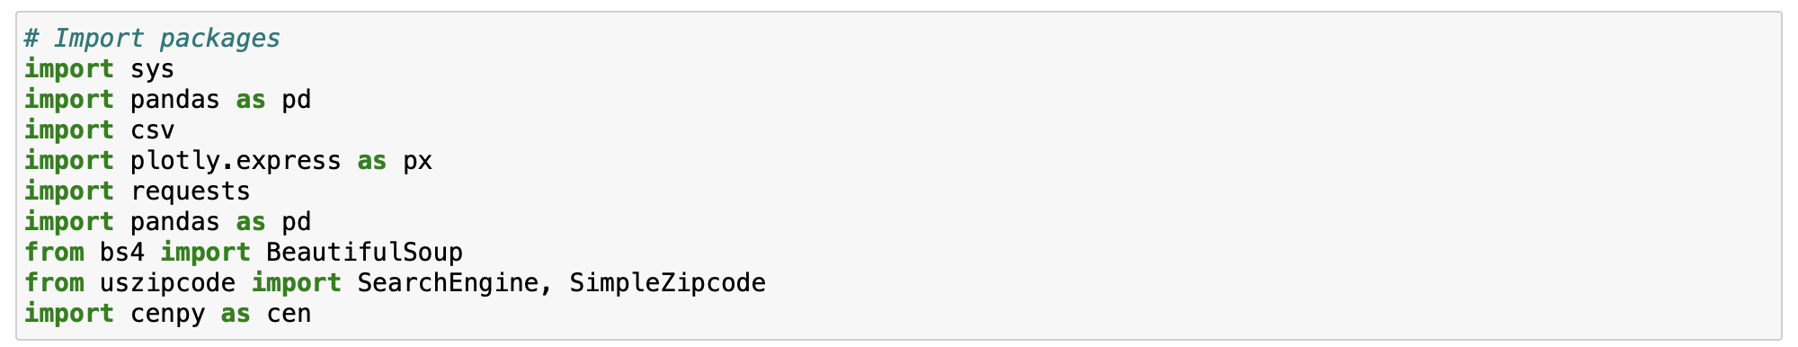
Scraping the Data I
Dependencies and Libraries:
4

Slide 6
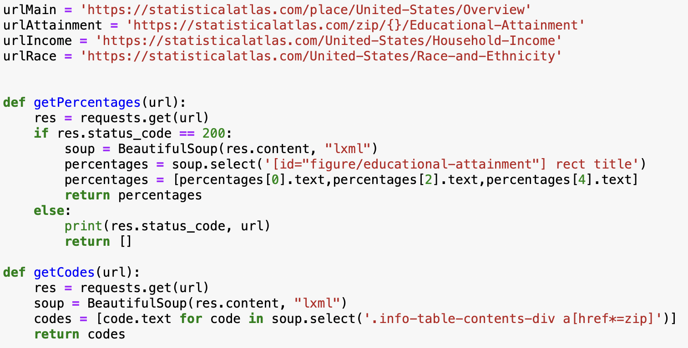
Scraping the Data II
5

Slide 7
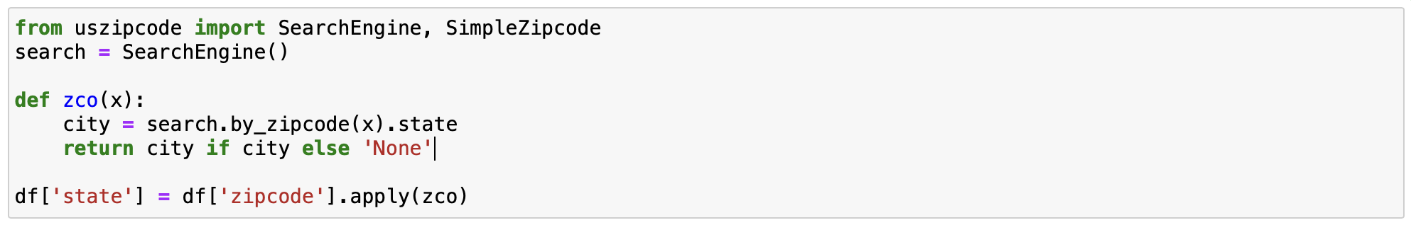

Modifying the Data
Take zip codes and re-allocate them to a given state:
Then merge the census data, the politico data and the statistics atlas data:
6

Slide 8
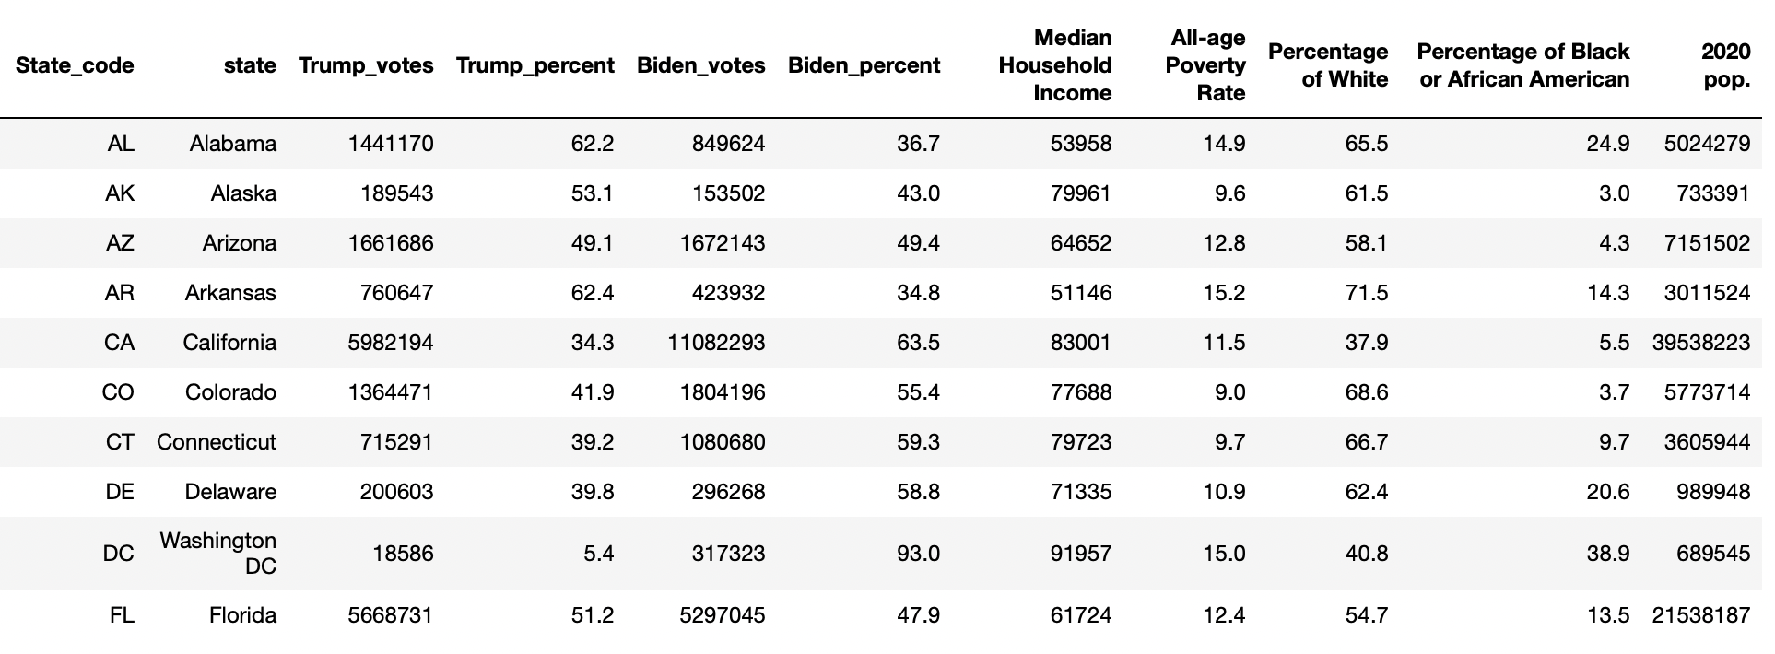
The Data
7

Slide 9
Analysis
8

Slide 10
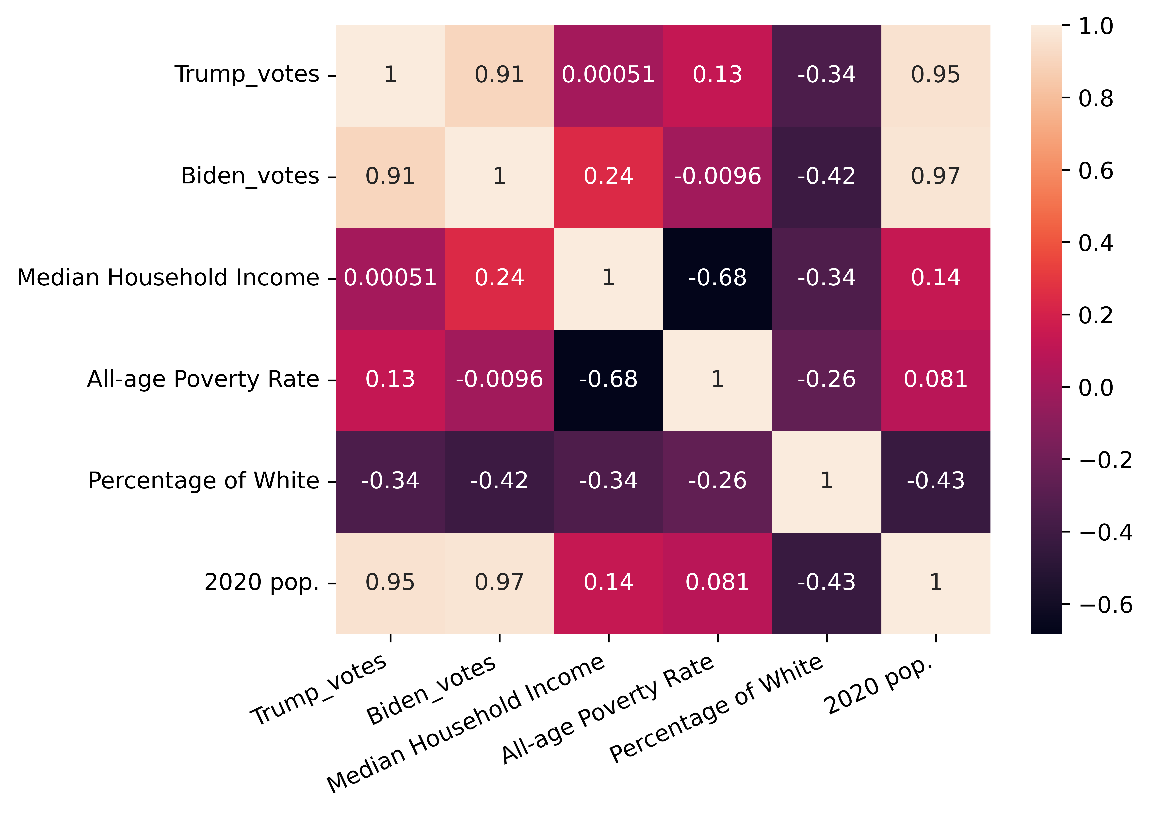
Correlation of Variables
9

Slide 11
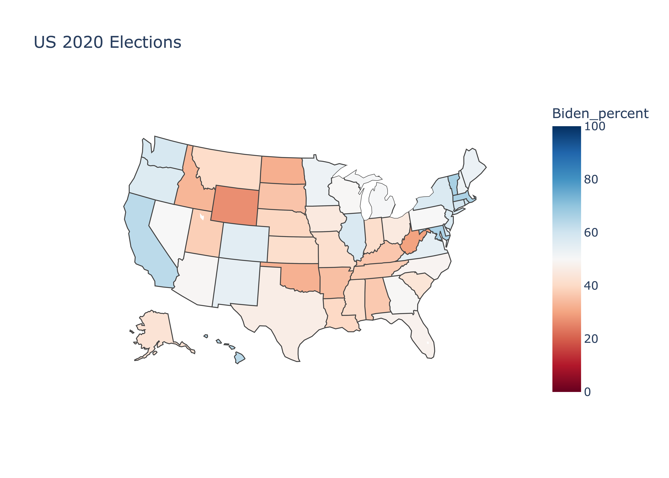
Spatial Visualisation of Votes
10

Slide 12
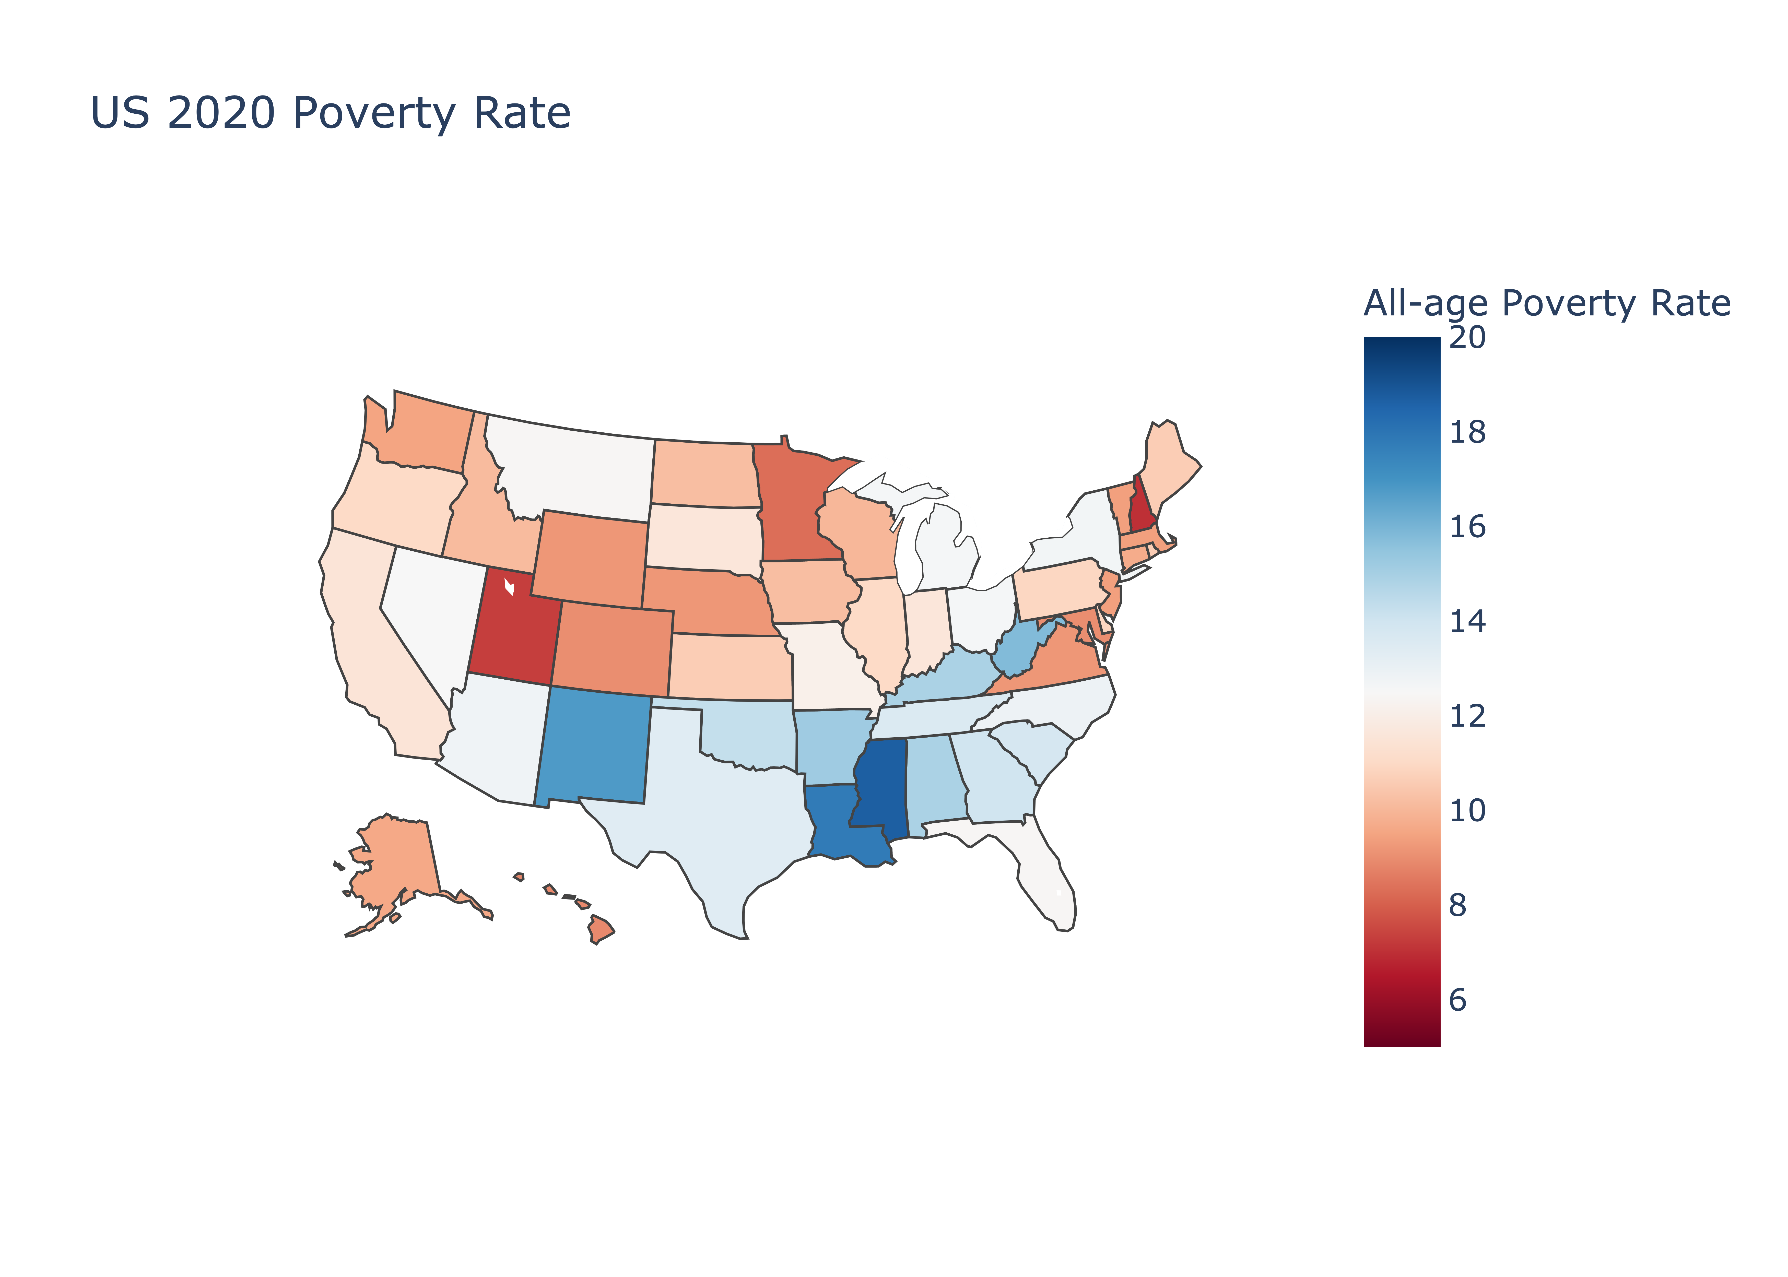
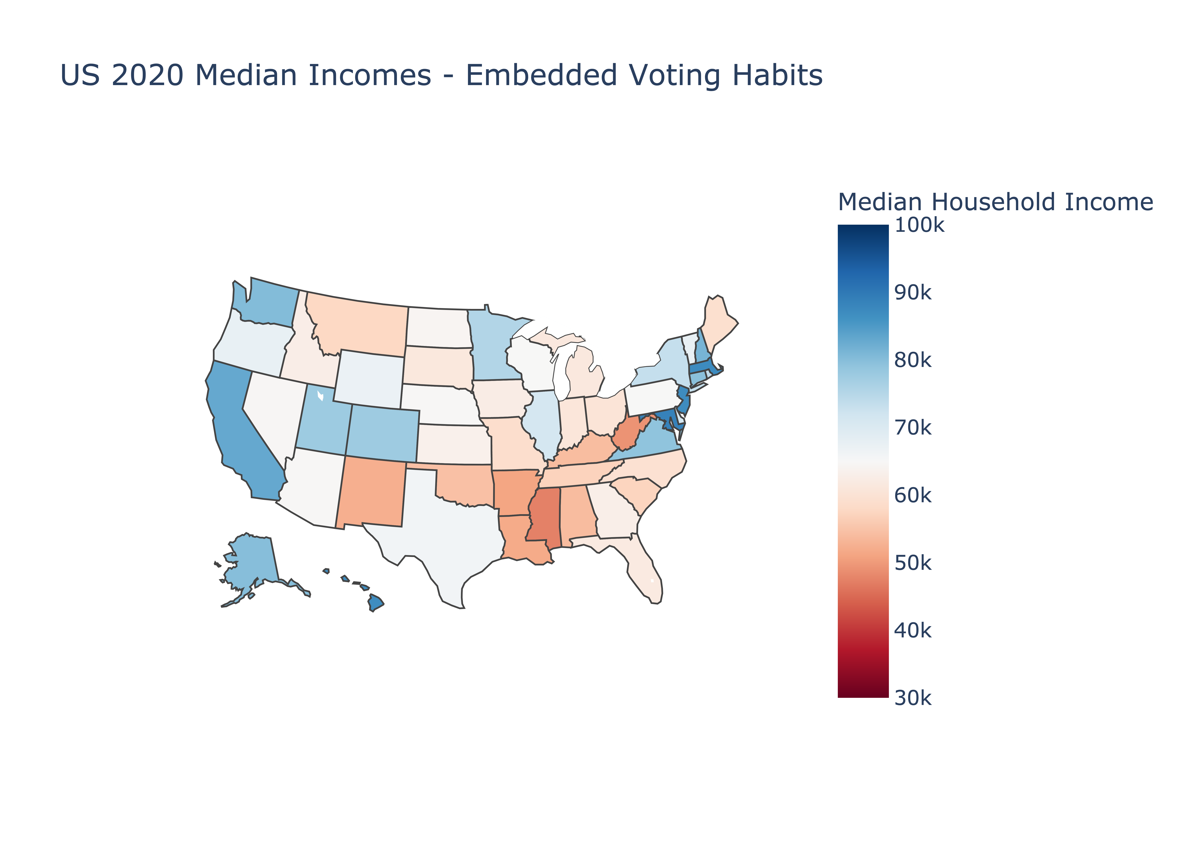
Spatial Visualisations Expanded
11

Slide 13
Voting Habits and Race
12

Slide 14
Thank You Any Questions?
13

